Slide 1


Chapter 4
Greedy
Algorithms
Slides by Kevin Wayne.
Copyright © 2005 Pearson-Addison Wesley.
All rights reserved.

Slide 2
4.1 Interval Scheduling

Slide 3
Interval Scheduling
Interval scheduling.
  Job j starts at s_{j} and finishes at f_{j}.
  Two jobs compatible if they don't overlap.
  Goal: find maximum subset of mutually compatible jobs.
a
b
c
d
e
f
g
h
Time
0
1
2
3
4
5
6
7
8
9
10
11
Notes:
Activity selection = interval scheduling
OPT = B, E, H
Note: smallest job (C) is not in any optimal solution, job that starts first (A) is not in any optimal solution.

Slide 4
Interval Scheduling: Greedy Algorithms
Greedy template. Consider jobs in some natural order.
Take each job provided it's compatible with the ones already taken.
  [Earliest start time] Consider jobs in ascending order of s_{j}.
  [Earliest finish time] Consider jobs in ascending order of f_{j}.
  [Shortest interval] Consider jobs in ascending order of f_{j} - s_{j}.
  [Fewest conflicts] For each job j, count the number of
  conflicting jobs c_{j}. Schedule in ascending order of c_{j}.

Slide 5
Interval Scheduling: Greedy Algorithms
Greedy template. Consider jobs in some natural order.
Take each job provided it's compatible with the ones already taken.
Counter example for earliest start time
Counter example for shortest interval
Counter example for fewest conflicts

Slide 6
Interval Scheduling: Greedy Algorithm
Greedy algorithm. Consider jobs in increasing order of finish time. Take each job provided it's compatible with the ones already taken.
Implementation. O(n log n) ← sorting time of finishing time of n jobs.
  Remember job j* that was added last to A.
  Job j is compatible with A if s_{j} ≥ f_{j*}. O(n) time to go through the sorted list of n jobs
Sort jobs by finish times so that f₁ ≤ f₂ ≤ ... ≤ f_{n}.
A ← φ
for j = 1 to n {
if (job j compatible with A)
A ← A ∪ {j}
}
return A
set of jobs selected

Slide 7
Interval Scheduling: Analysis
Theorem. Greedy algorithm is optimal.
Pf. (by contradiction)
  Assume greedy is not optimal, and let's see what happens.
  Let i₁, i₂, ... i_{k} denote set of jobs selected by greedy.
  Let j₁, j₂, ... j_{m} denote set of jobs in the optimal solution with
  i₁ = j₁, i₂ = j₂, ..., i_{r} = j_{r} for the largest possible value of r.
job i_{r+1} finishes before j_{r+1}
Greedy:
i₁
i₂
i_{r}
i_{r+1}
OPT:
j₁
j₂
j_{r}
j_{r+1}
. . .
why not replace job j_{r+1}
with job i_{r+1}?

Slide 8
Interval Scheduling: Analysis
Theorem. Greedy algorithm is optimal.
Pf. (by contradiction)
  Assume greedy is not optimal, and let's see what happens.
  Let i₁, i₂, ... i_{k} denote set of jobs selected by greedy.
  Let j₁, j₂, ... j_{m} denote set of jobs in the optimal solution with
  i₁ = j₁, i₂ = j₂, ..., i_{r} = j_{r} for the largest possible value of r.
job i_{r+1} finishes before j_{r+1}
Greedy:
i₁
i₂
i_{r}
i_{r+1}
OPT:
j₁
j₂
j_{r}
i_{r+1}
. . .
solution still feasible and optimal, but contradicts maximality of r.

Slide 9
4.1 Interval Partitioning
Interval scheduling so far is using a single resource.
Extension: What if we have multiple resources for scheduling tasks?
Assumption: all resources are equivalent

Slide 10
Interval Partitioning
Interval partitioning.
  Lecture j starts at s_{j} and finishes at f_{j}.
  Goal: find minimum number of classrooms to schedule all lectures
  so that no two occur at the same time in the same room.
Ex: This schedule uses 4 classrooms to schedule 10 lectures.
4
e
j
3
c
d
g
2
b
h
1
a
f
i
9
9:30
10
10:30
11
11:30
12
12:30
1
1:30
2
3
3:30
4
4:30
Time

Slide 11
Interval Partitioning
Interval partitioning.
  Lecture j starts at s_{j} and finishes at f_{j}.
  Goal: find minimum number of classrooms to schedule all lectures
  so that no two occur at the same time in the same room.
Ex: This schedule uses only 3.
3
c
d
f
j
2
b
g
i
1
a
e
h
9
9:30
10
10:30
11
11:30
12
12:30
1
1:30
2
3
3:30
4
4:30
Time

Slide 12
Interval Partitioning: Lower Bound on Optimal Solution
Def. The depth of a set of open intervals is the maximum number that contain all concurrent intervals at any given time.
Key observation. Number of classrooms needed ≥ depth.
Ex: Depth of schedule below = 3 ⇒ schedule below is optimal.
Q. Does there always exist a schedule equal to depth of intervals?
a, b, c all contain 9:30
3
c
d
f
j
2
b
g
i
1
a
e
h
9
9:30
10
10:30
11
11:30
12
12:30
1
1:30
2
3
3:30
4
4:30
Time

Slide 13
Interval Partitioning: Greedy Algorithm
Greedy algorithm. Consider lectures in increasing order of start time: assign lecture to any compatible classroom.
Implementation. O(n log n).
Sort intervals by starting time so that s₁ ≤ s₂ ≤ ... ≤ s_{n}.
d ← 0
for j = 1 to n {
if (lecture j is compatible with some classroom k)
schedule lecture j in classroom k
else
allocate a new classroom d + 1
schedule lecture j in classroom d + 1
d ← d + 1
}
number of allocated classrooms
Notes:
priority queue keyed by the finish time of the last job added

Slide 14
Interval Partitioning: Greedy Analysis
Observation. Greedy algorithm never schedules two incompatible lectures in the same classroom.
Theorem. Greedy algorithm is optimal.
Pf.
  Let d = number of classrooms that the greedy algorithm allocates.
  Classroom d is opened because we needed to schedule a job, say j, that is incompatible with all d-1 other classrooms.
  These d-1 jobs each end after s_{j} (because of incompatible).
  Since we sorted by start time, all these incompatibilities are caused by lectures that start no later than s_{j}.
  Thus, we have d lectures overlapping at time s_{j} + ε.
  Key observation ⇒ all schedules use ≥ d classrooms. ▪

Slide 15
4.2 Scheduling to Minimize Lateness
What if all jobs do not have predefined fixed starting time?
Use a single resource to complete all jobs one after another

Slide 16
Scheduling to Minimizing Lateness
Minimizing lateness problem.
  Single resource processes one job at a time.
  Job j requires t_{j} units of processing time and is due at time d_{j}.
  If j starts at time s_{j}, it finishes at time f_{j} = s_{j} + t_{j}.
  Lateness: _{j} = max { 0, f_{j} - d_{j} }.
  Goal: schedule all jobs to minimize maximum lateness L = max _{j}.
Ex:
Job scheduled order: 3, 2, 6, 1, 5, 4
Lateness check:
1
2
3
4
5
6
t_{j}
3
2
1
4
3
2
d_{j}
6
8
9
9
14
15
lateness = 2
lateness = 0
max lateness = 6
d₃ = 9
d₂ = 8
d₆ = 15
d₁ = 6
d₅ = 14
d₄ = 9
0
1
2
3
4
5
6
7
8
9
10
11
12
13
14
15
Notes:
Note: finding a maximal size subset of jobs that meet deadline is NP-hard.

Slide 17
Minimizing Lateness: Greedy Algorithms
Greedy template. Consider jobs in some order.
  [Shortest processing time first] Consider jobs in ascending order of processing time t_{j}.
  [Earliest deadline first] Consider jobs in ascending order of deadline d_{j}.
  [Smallest slack] Consider jobs in ascending order of slack d_{j} - t_{j}.

Slide 18
Minimizing Lateness: Greedy Algorithms
Greedy template. Consider jobs in some order.
  [Shortest processing time first] Consider jobs in ascending order of processing time t_{j}.
  [Smallest slack] Consider jobs in ascending order of slack d_{j} - t_{j}.
1
2
t_{j}
1
10
counterexample
d_{j}
100
10
1
2
t_{j}
1
10
counterexample
d_{j}
2
10

Slide 19
Minimizing Lateness: Greedy Algorithm
Greedy algorithm. Earliest deadline first.
Sort n jobs by deadline so that d₁ ≤ d₂ ≤ … ≤ d_{n}
t ← 0
for j = 1 to n
Assign job j to interval [t, t + t_{j}]
s_{j} ← t, f_{j} ← t + t_{j}
t ← t + t_{j}
output intervals [s_{j}, f_{j}]
1
2
3
4
5
6
t_{j}
3
2
1
4
3
2
d_{j}
6
8
9
9
14
15
max lateness = 1
d₁ = 6
d₂ = 8
d₃ = 9
d₄ = 9
d₅ = 14
d₆ = 15
0
1
2
3
4
5
6
7
8
9
10
11
12
13
14
15

Slide 20
Minimizing Lateness: No Idle Time
Observation. There exists an optimal schedule with no idle time.
Observation. The greedy schedule has no idle time.
d = 4
d = 6
d = 12
0
1
2
3
4
5
6
7
8
9
10
11
d = 4
d = 6
d = 12
0
1
2
3
4
5
6
7
8
9
10
11
Notes:
"machine not working for some reason, yet work still to be done"

Slide 21
Minimizing Lateness: Inversions
Def. Given a schedule S, an inversion is a pair of jobs i and j such that:
d_{i} < d_{j} but j scheduled before i.
Observation. Greedy schedule has no inversions and no idle time.
Observation. If a schedule (with no idle time) has an inversion, it has at least one inversion with a pair of inverted jobs scheduled consecutively.
inversion
f_{i}
before swap
j
i
[ as before, we assume jobs are numbered so that d₁ ≤ d₂ ≤ … ≤ d_{n} ]
Notes:
Recall: jobs sorted in ascending order of due dates

Slide 22
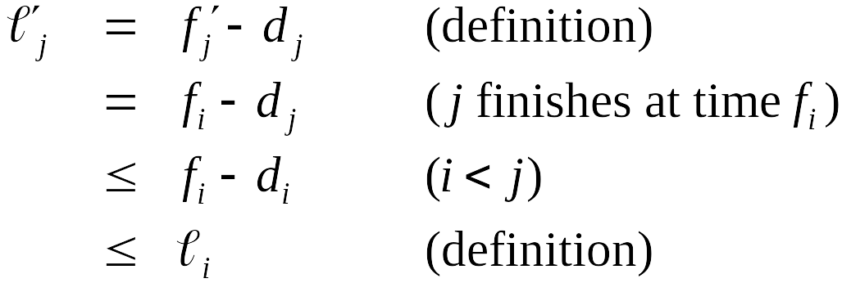
Minimizing Lateness: Inversions
Def. Given a schedule S, an inversion is a pair of jobs i and j such that:
i < j but j scheduled before i.
Claim. Swapping two consecutive, inverted jobs reduces the number of inversions by one and does not increase the max lateness.
Pf. Let l be the lateness before the swap, and let l ' be it afterwards.
  ● l '_{k} =  l _{k} for all k ≠ i, j
  ● l '_{i} ≤  l _{i}
  If job j is late:
inversion
f_{i}
before swap
j
i
after swap
i
j
f'_{j}
Notes:
fi - di <= max {0, fi - di} = li

Slide 23
Claim. All schedules with no inversion and no idle time have the same maximum lateness.
Pf. Two such schedules must differ in the order in which jobs with identical deadlines are scheduled.
Jobs with this same deadline are scheduled consecutively.
The last of these jobs have the largest lateness, not depend on the order of these jobs.

Slide 24
Minimizing Lateness: Analysis of Greedy Algorithm
Theorem. Greedy schedule S is optimal.
Pf. Define S* to be an optimal schedule that has the fewest number of inversions, and let's see what happens.
  Can assume S* has no idle time.
  If S* has no inversions, then S = S* (greedy schedule result S is also with no inversions and idle time)
  If S* has an inversion, let i-j be an adjacent inversion.
    swapping i and j does not increase the maximum lateness and strictly decreases the number of inversions
    this contradicts definition of S* ▪

Slide 25
Greedy Analysis Strategies
Greedy algorithm stays ahead. Show that after each step of the greedy algorithm, its solution is at least as good as any other algorithm's.
Structural. Discover a simple "structural" bound asserting that every possible solution must have a certain value. Then show that your algorithm always achieves this bound.
Exchange argument. Gradually transform any solution to the one found by the greedy algorithm without hurting its quality.
Other greedy algorithms. Kruskal, Prim, Dijkstra, Huffman, …
Notes:
Hard, if not impossible, to precisely define "greedy algorithm." Though there are some formalizations, e.g., matroids.
myopic
greedy: "at every iteration, the algorithm chooses the best morsel it can swallow, without worrying about the future"
Objective function. Does not explicitly appear in greedy algorithm!

Slide 26
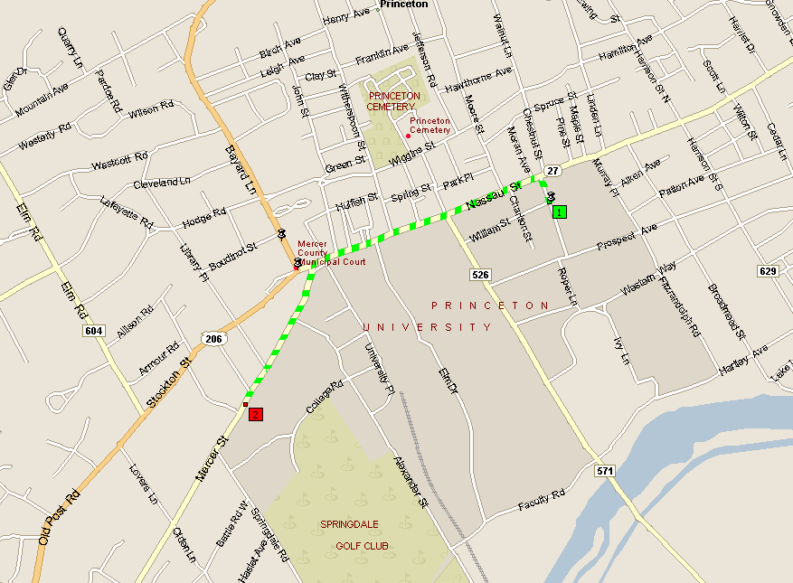
4.4 Shortest Paths in a Graph
shortest path from Princeton CS department to Einstein's house
Notes:
map from Microsoft Streets and Trips

Slide 27
Shortest Path Problem
Shortest path network.
  Directed graph G = (V, E).
  Source s, destination t.
  Length _{e} = length of edge e.
Shortest path problem: find shortest directed path from s to t.
cost of path = sum of edge costs in path
2
23
3
9
s
18
Cost of path s-2-3-5-t
= 9 + 23 + 2 + 16
= 50.
14
2
6
6
30
11
4
19
15
5
5
20
16
6
7
44
t

Slide 28
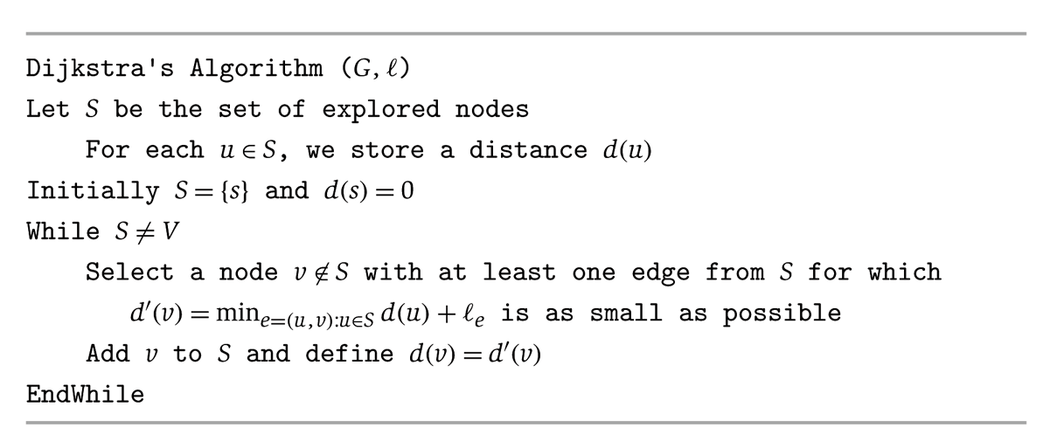
Dijkstra's Algorithm
_{e}
v
d(u)
u
S
s

Slide 29
Dijkstra's Algorithm
_{e}
v
d(u)
u
S
s
Notes:
S is only needed for the proof of correctness, not the algorithm itself

Slide 30
Dijsktra’s Algorithm (another description)
1 Initialization:
2 S = {s}
3 for all nodes v
4 if v adjacent to node s
5 then D’(v) = c(s,v)
6 else D’(v) = infinity
7
8 Loop
9 find v not in S such that D’(v) is a minimum
10 add v to S and set D(v) =D’(v)
11 update D’(w) for all w adjacent to v and not in S:
12 D’(w) = min( D’(w), D(v) + c(v,w) )
13 /* new cost to w is either old cost to w or known
14 shortest path cost to v plus direct link cost from v to w */
15 until all nodes in S
Network Layer
4-<number>

Slide 31
Dijkstra's Algorithm: Proof of Correctness
Invariant. For each node u ∈ S, d(u) is the length of the shortest s-u path.
Pf. (by induction on |S|)
Base case: |S| = 1 is trivial.
Inductive hypothesis: Assume true for |S| = k ≥ 1.
  Let v be next node added to S, and let u-v be the chosen edge.
  The shortest s-u path plus (u, v) is an s-v path of length d(v).
  Consider any s-v path P. We'll see that it's no shorter than d(v).
  Let x-y be the first edge in P that leaves S,
  and let P' be the subpath to x.
  P is already too long as soon as it leaves S.
P
P'
x
y
s
S
u
● (P) ≥  (P') +  (x,y) ≥ d(x) +  (x, y) ≥ d’(y) ≥ d’(v)
v
nonnegative
weights
inductive
hypothesis
defn of d’(y)
Dijkstra chose v
instead of y
Notes:
Consider any path P from s to v. It is already at least as long as π(v) by the time it leaves S.

Slide 32
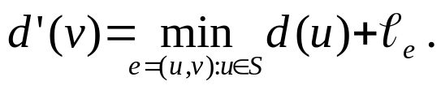

Dijkstra's Algorithm: Implementation
For each unexplored node, explicitly maintain
  Next node to explore = node with minimum d’(v).
  When exploring v (adding v to S), for each incident edge e = (v, w), update
Efficient implementation. Maintain a priority queue of unexplored nodes, prioritized by d’(v).
Priority Queue

